Slide 1

Notes:
Smallish village West Oxfordshire

Slide 2



Notes:
Douglas : Covid starting to work for Bioregional, told us about Low Carbon Hub and CAG: very helpful in many ways: insurance/ promotion/ meeting Bruton/Repair Café: contacts, training, PAT testing course / equipment (Oxford Library of things) /composting/food fermentation etc

Slide 3

Bioregional and One Planet Living
Bioregional are a social enterprise which champions a better, more sustainable way to live.
Current UK life styles =
Create places that enable people to live happy, healthy lives within the natural limits of the planet leaving space for wildlife and wilderness.
Notes:
Inspired by One Planet Bruton too

Slide 4

One Planet Living Framework
These ten simple principles which provide a common language to talk about sustainability and to drive positive change.

Slide 5
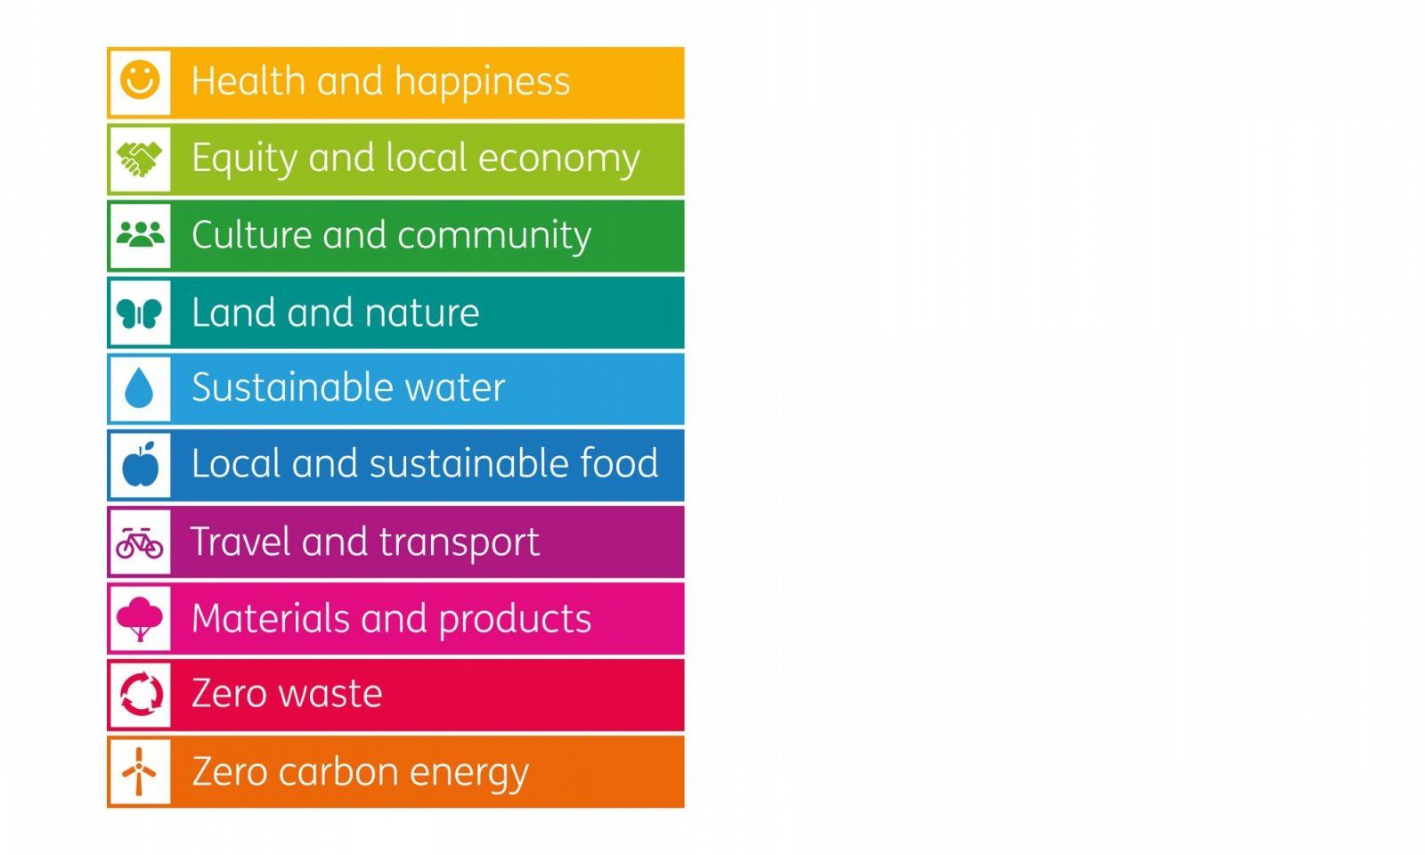

Slide 6
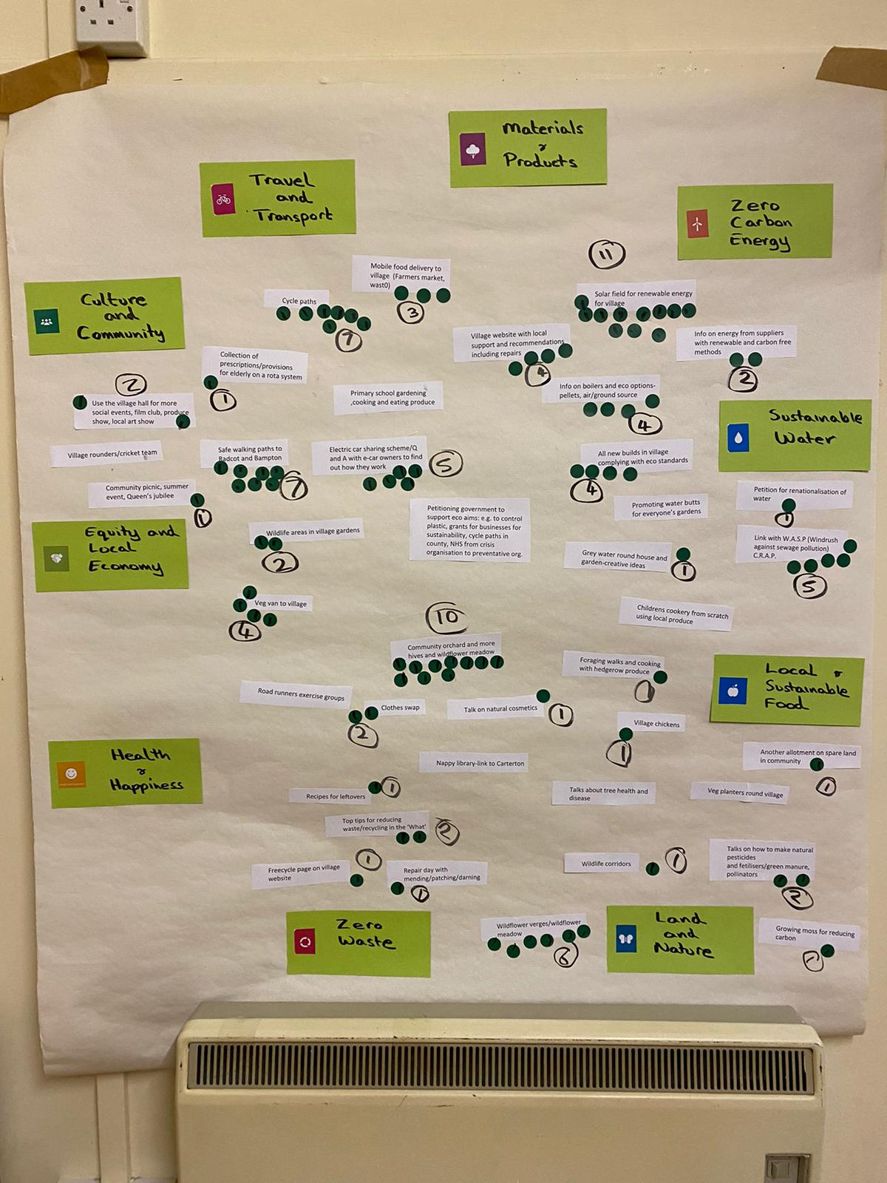
What is One Planet Clanfield?
Aim: to provide a forum for the local community to learn about living sustainably and to encourage each other to take positive action towards living within the natural limits of the planet.
Notes:
Run by volunteers from Clanfield and local area. We have 3 officers and tempate for a constitution(took all advice from CAG) and different people volunteer for roles they are interested in.

Slide 7
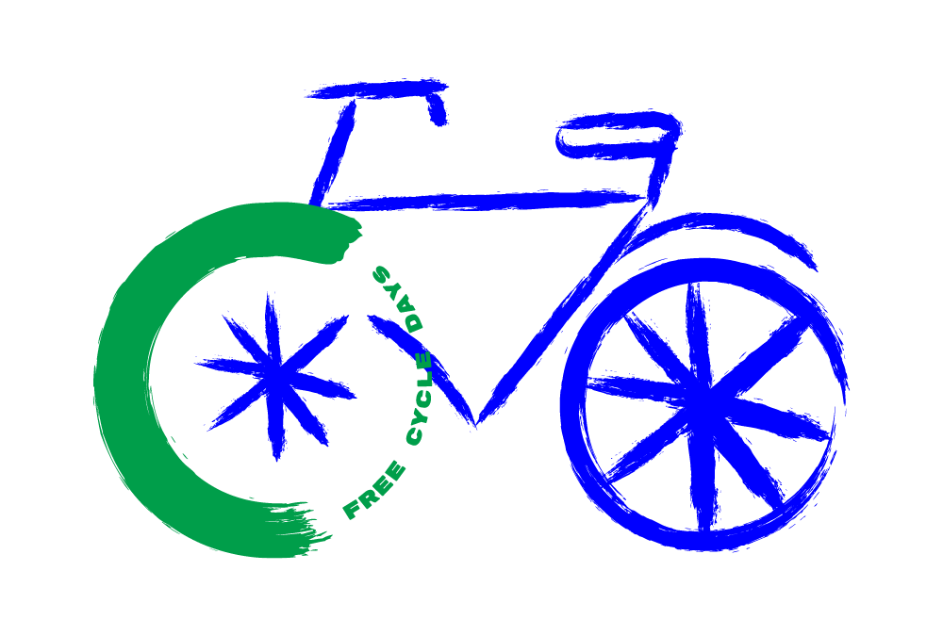



Notes:
Alissa Thaler designed our logos for free.
One Planet Bruton : Freecycling and Sustainable Saturdays

Slide 8
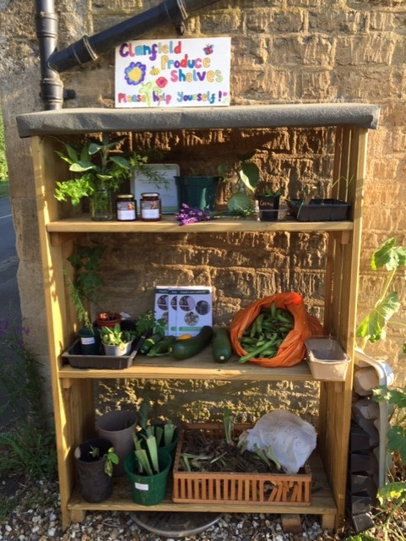
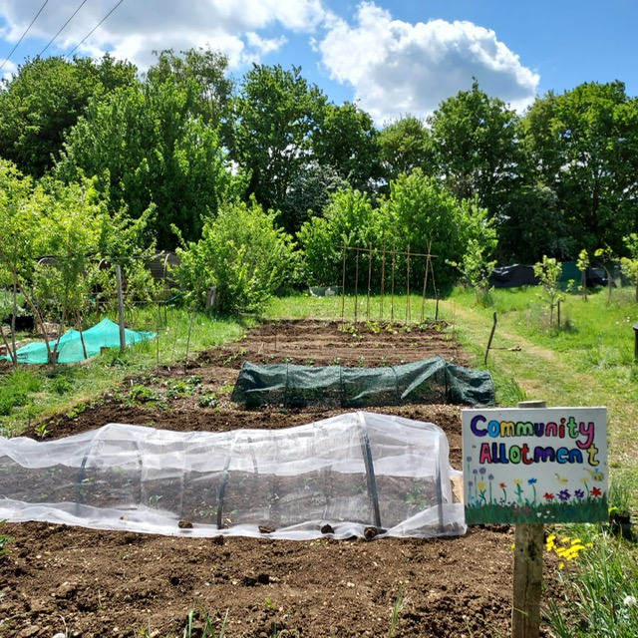
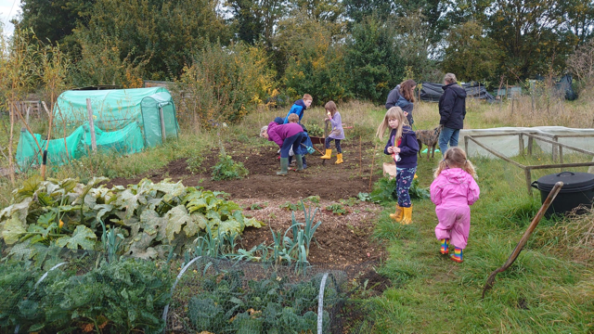
Notes:
CAG advice about community growing, talks, offered composting sessions etc. Grant from local charity shop for shed and some garden tools etc. Sharing Shelves – free exchange of surplus produce and plants
Local youth club: crop scarers for the allotment

Slide 9
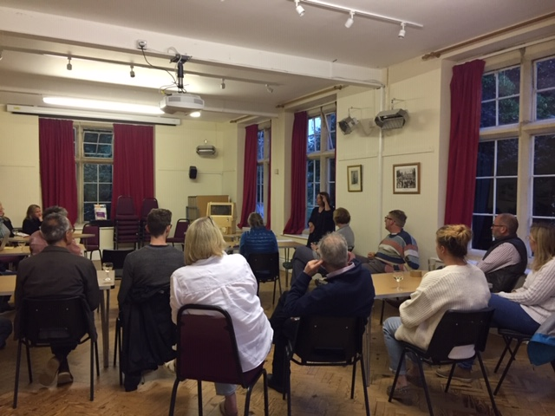
Spring 2022
Bee Keeping
Composting
Low Carbon Hub
Ethical and sustainable investments
UK Energy Infrastructure
Off Grid Living
Waste and Recycling in the 21st century Grundon
Autumn/winter 2022
Food Waste
Rewilding
Wild Oxfordshire
Workshops……
Notes:
Anaïs CAG talk about composting,
Workshops :

Slide 10

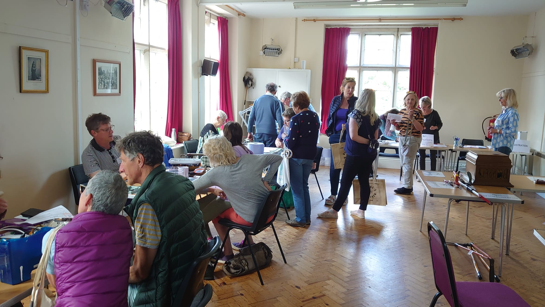
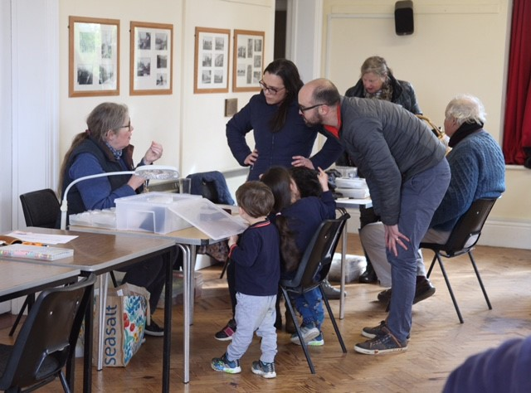
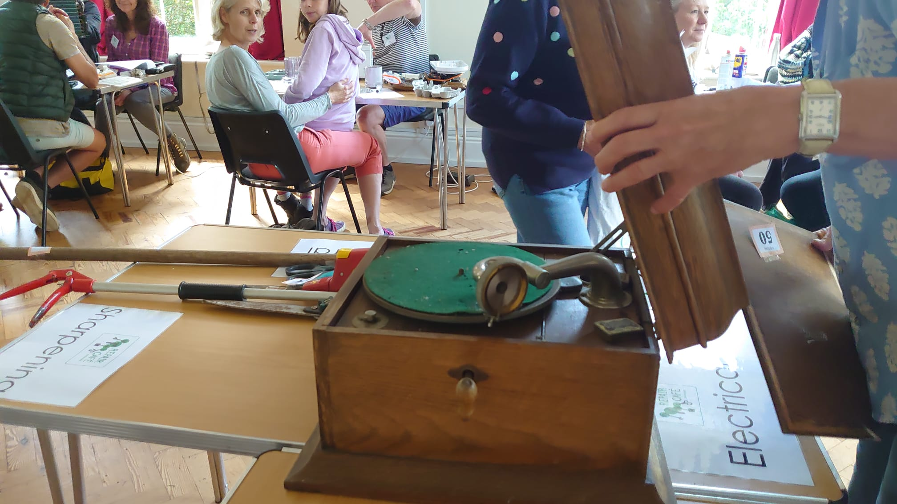
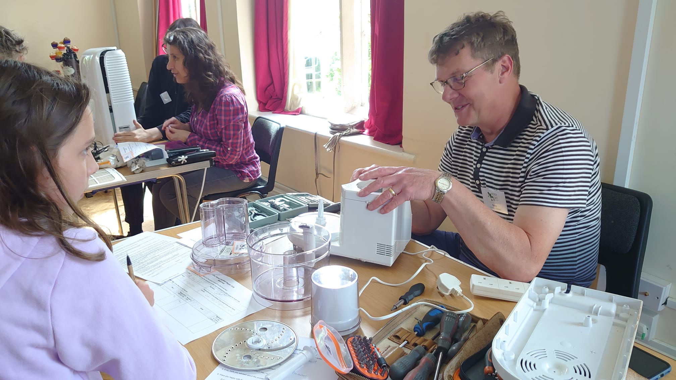
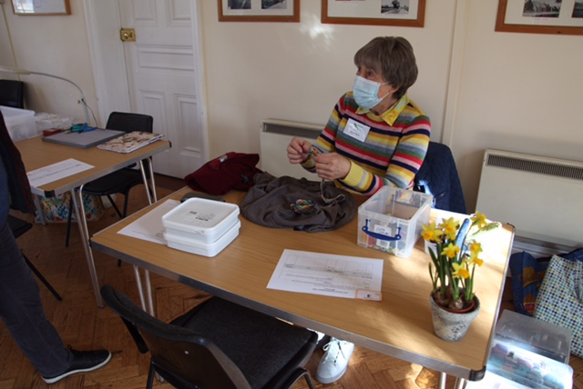
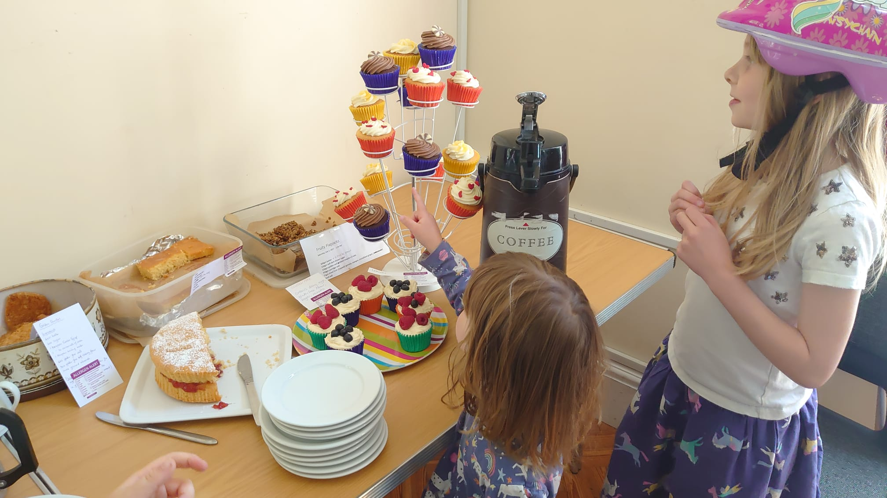
Notes:
CAG grants special project grant, now it is self funding and sustainable
Oxford Library of Things – PAT tester then shared kit with Eynsham Repair Café

Slide 11




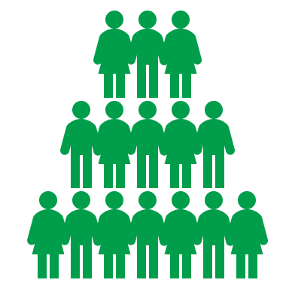







145
Repair
Cafés
Items Repaired
3
90%
Rate of Repair
154.8 Kg Saved from Landfill
29
Volunteer Repairers
200+
Visitors
19
Electrical Items Fixed
13
Items of Clothing Repaired
73
Items Sharpened
What visitors said:
Friendly helpful people….
Great community feel….
Extremely useful….Friendly, helpful, skilled….Buzzy & great venture ….wonderful ….Fantastic....
Very happy
Some of the items repaired
Waffle Maker, Toasters, Earings, Necklaces, Garden Shears, CD Player, Lamps, Child’s Tiara, Bathroom Scales, Jumpers, Trousers, Ash Vacuum……
180+ Cups of Tea
16 Cakes
Notes:
Data from 3 Repair Cafés – all to CAG (landfill

Slide 12
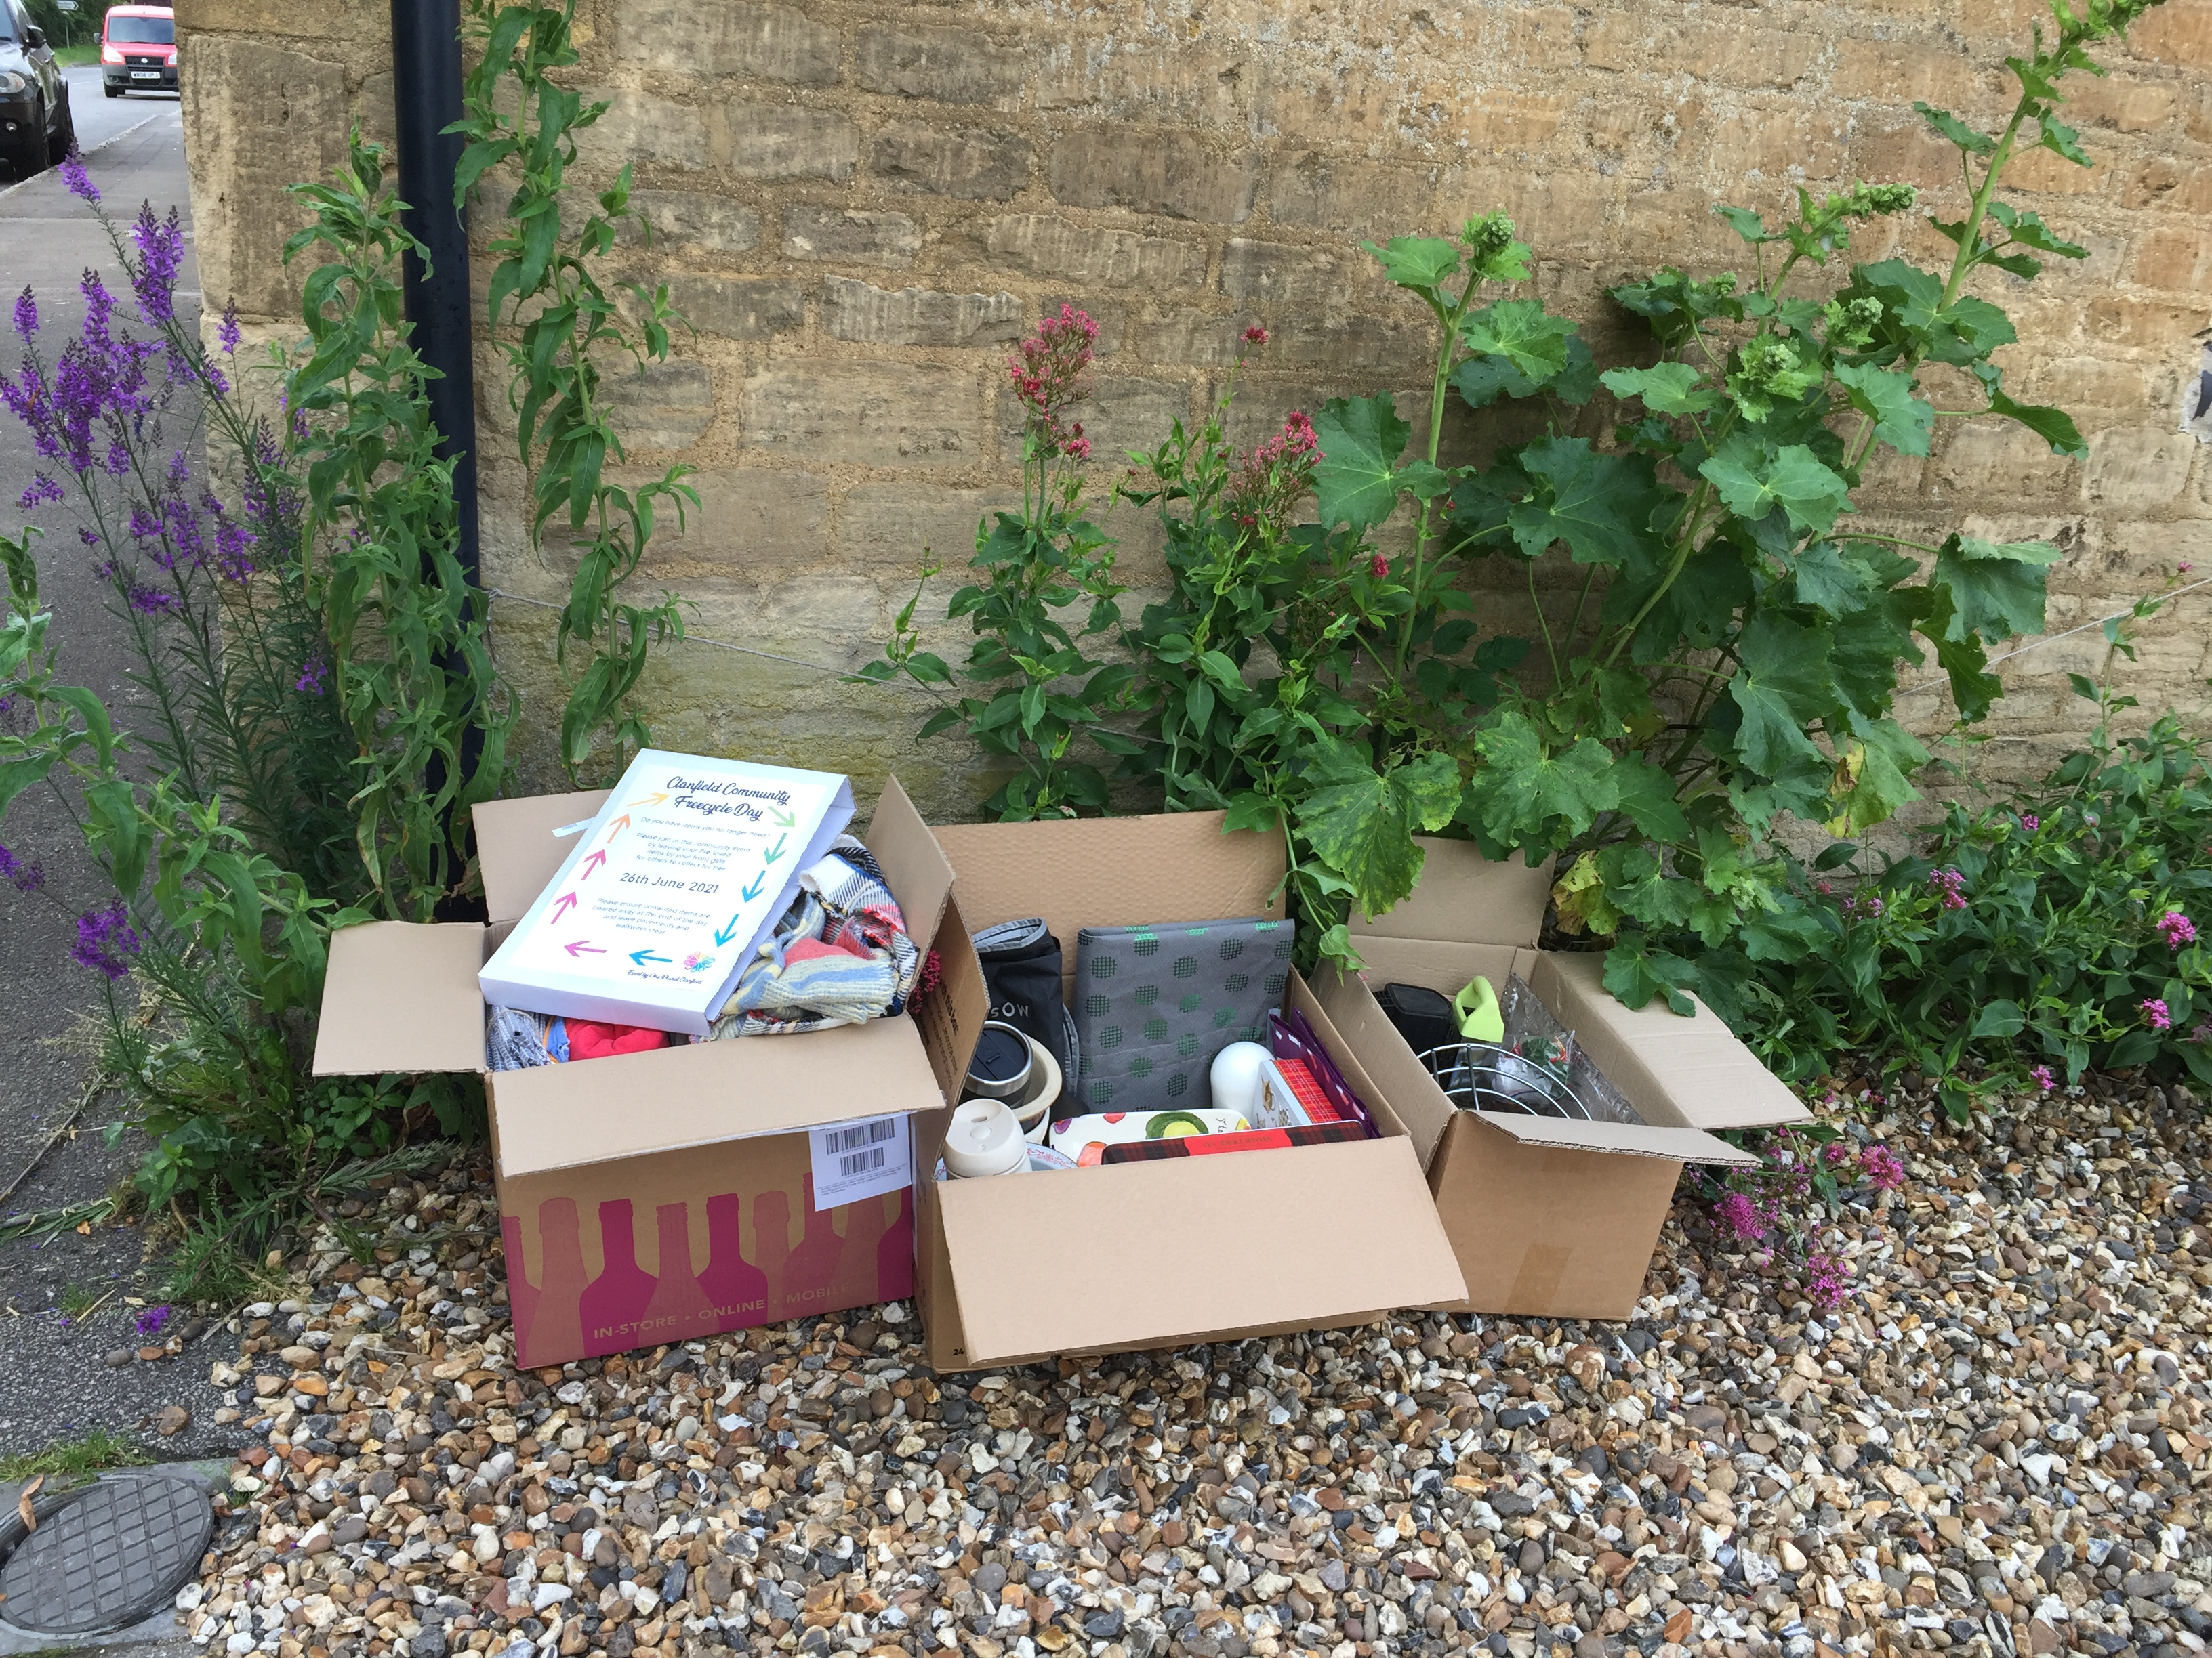
Notes:
Inspired by Bruton

Slide 13
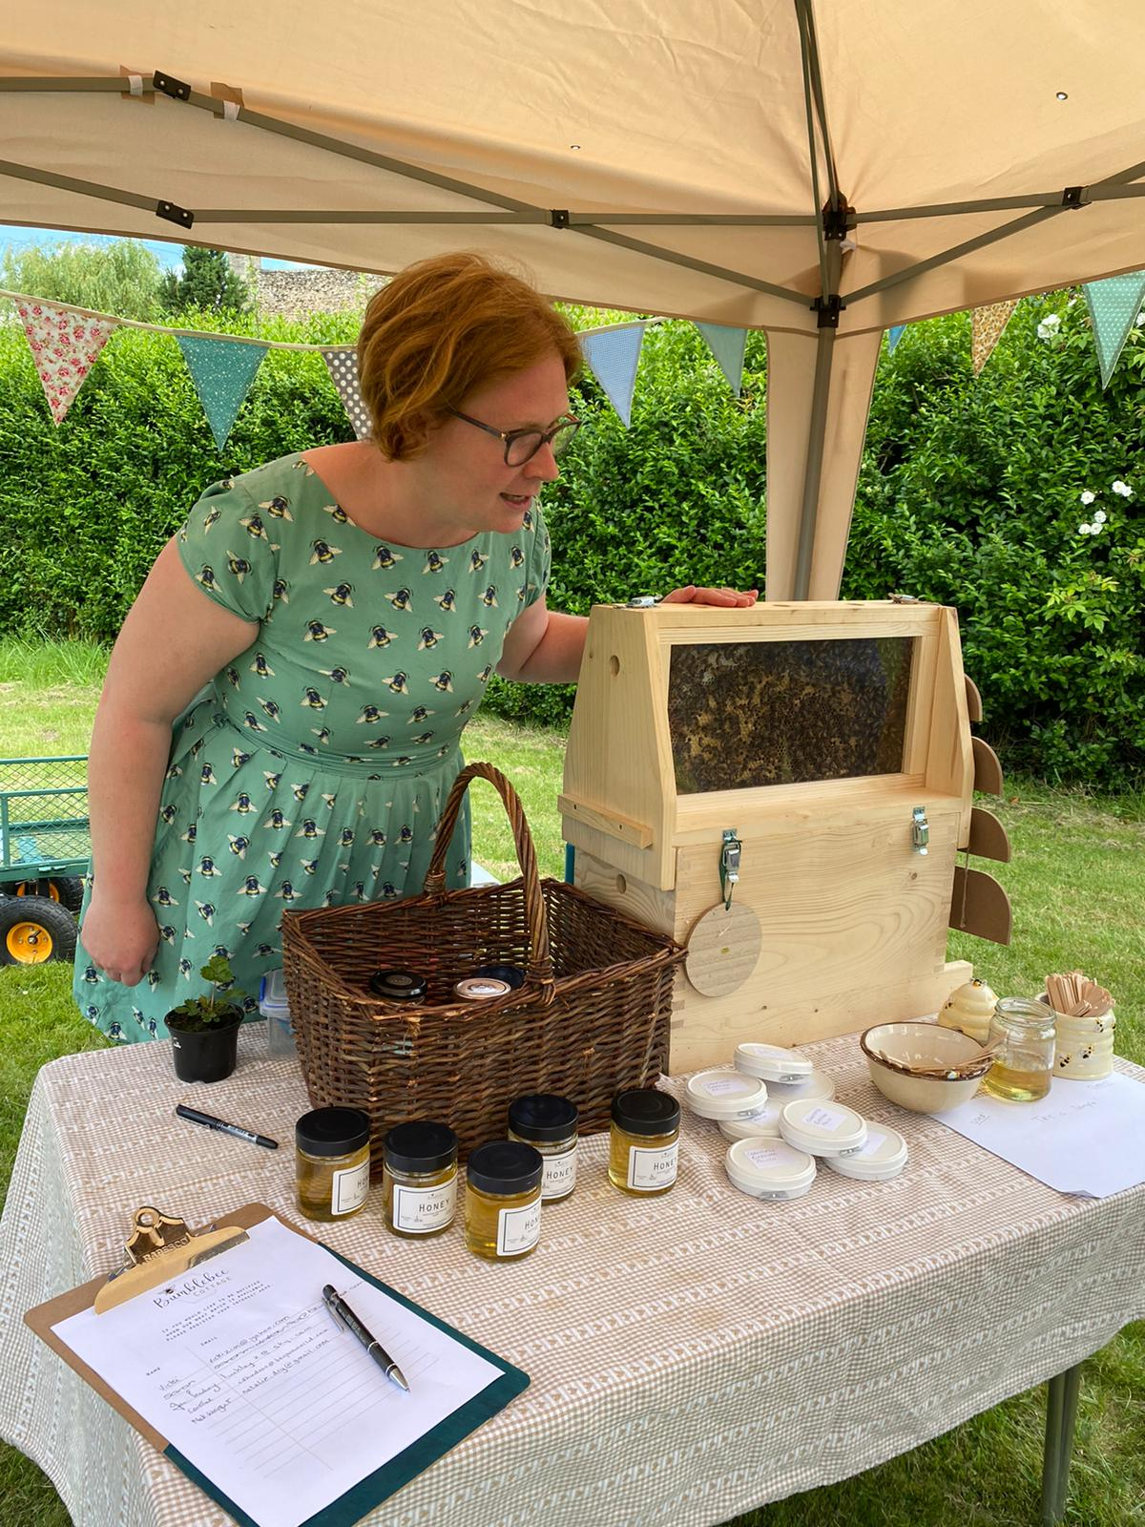
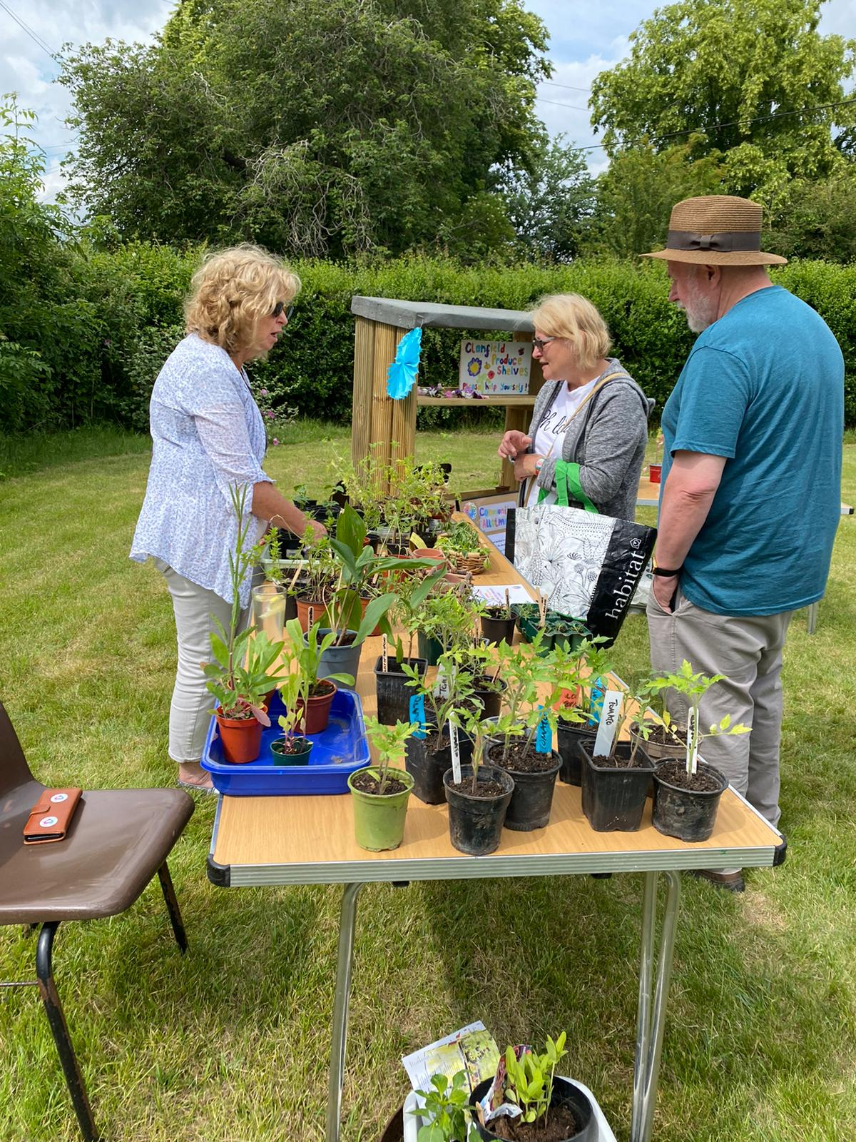
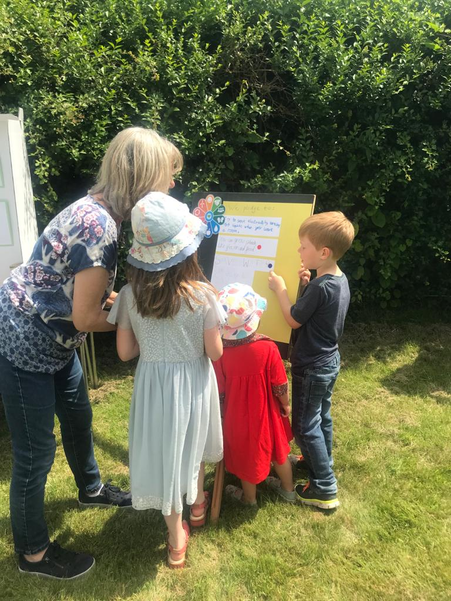
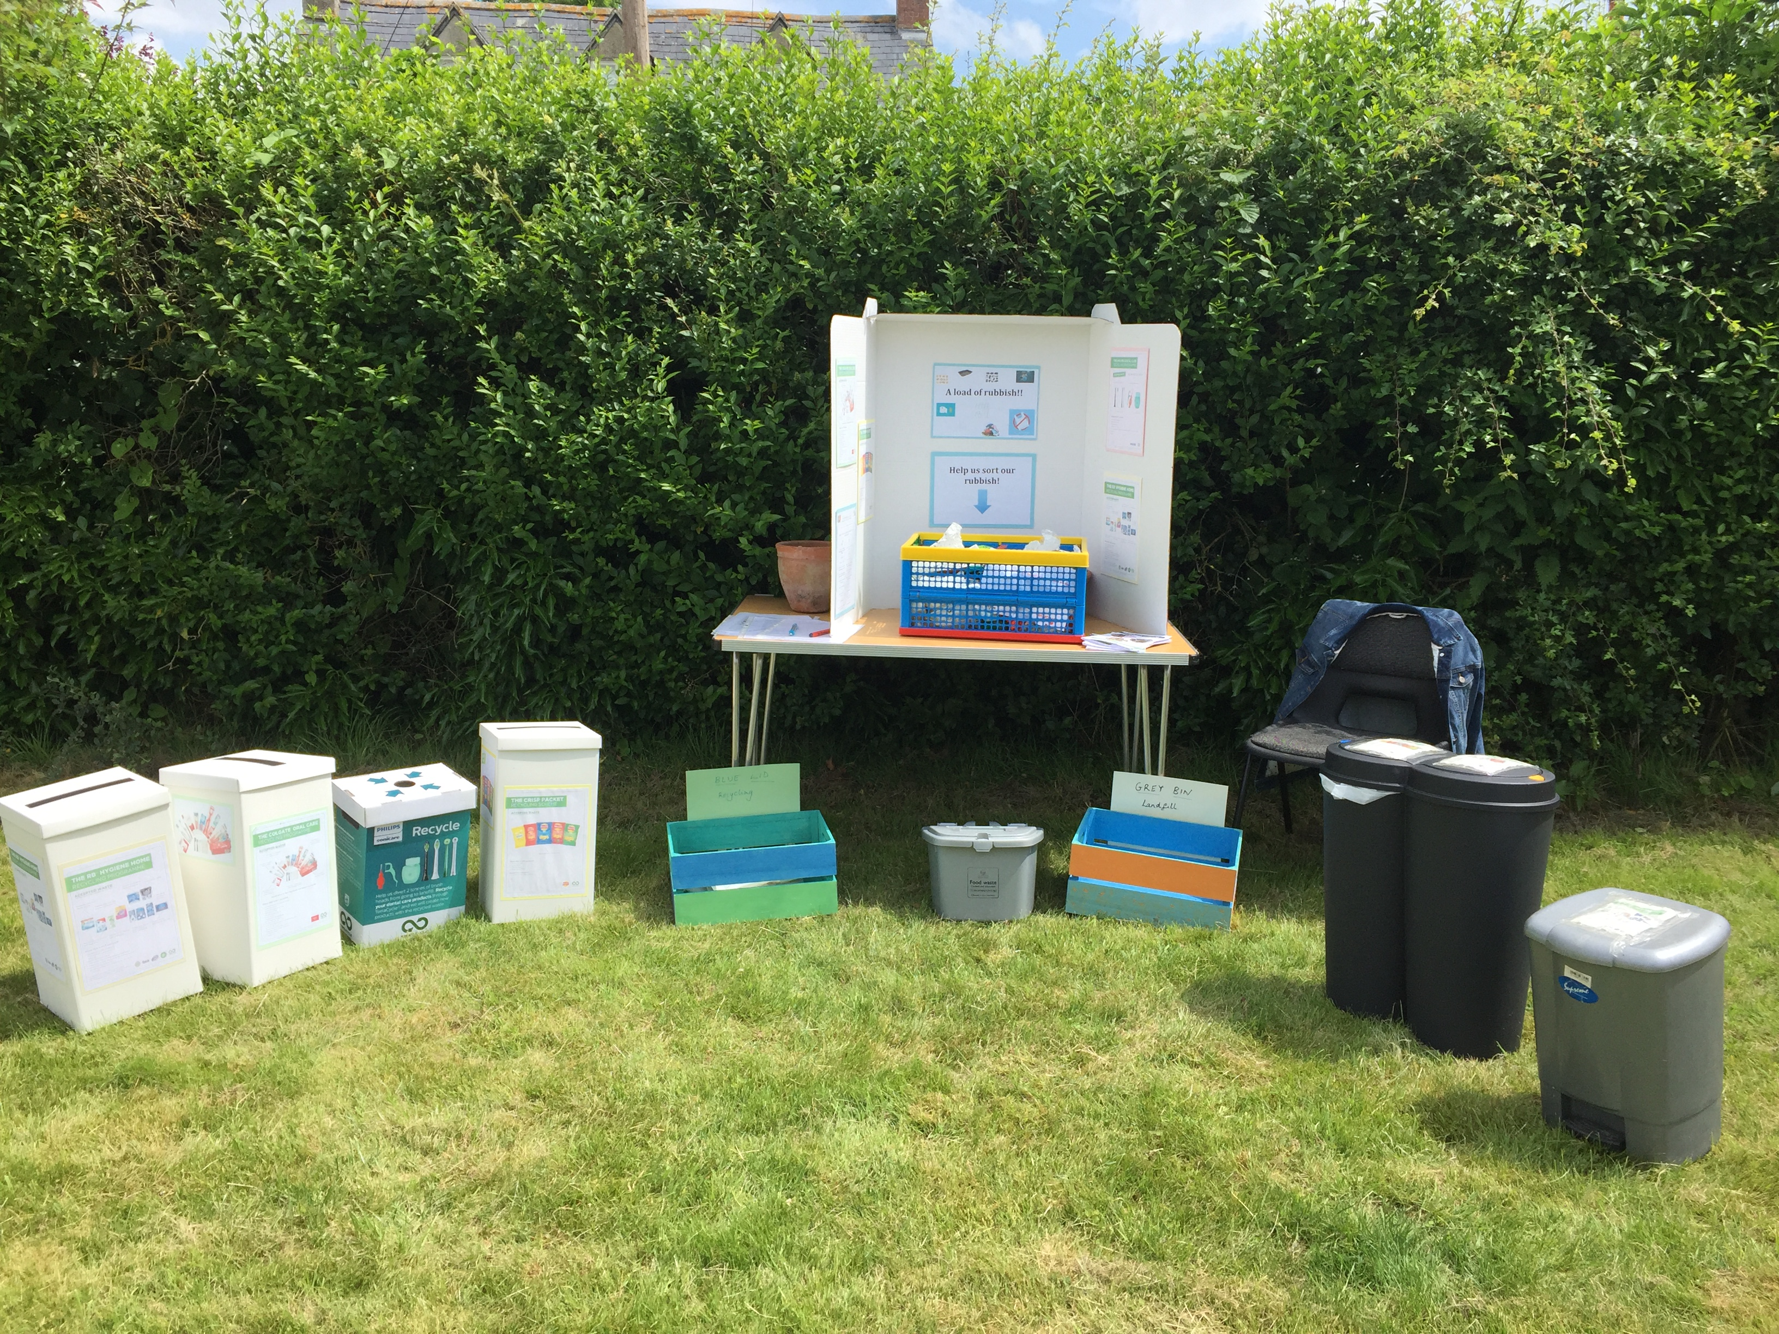
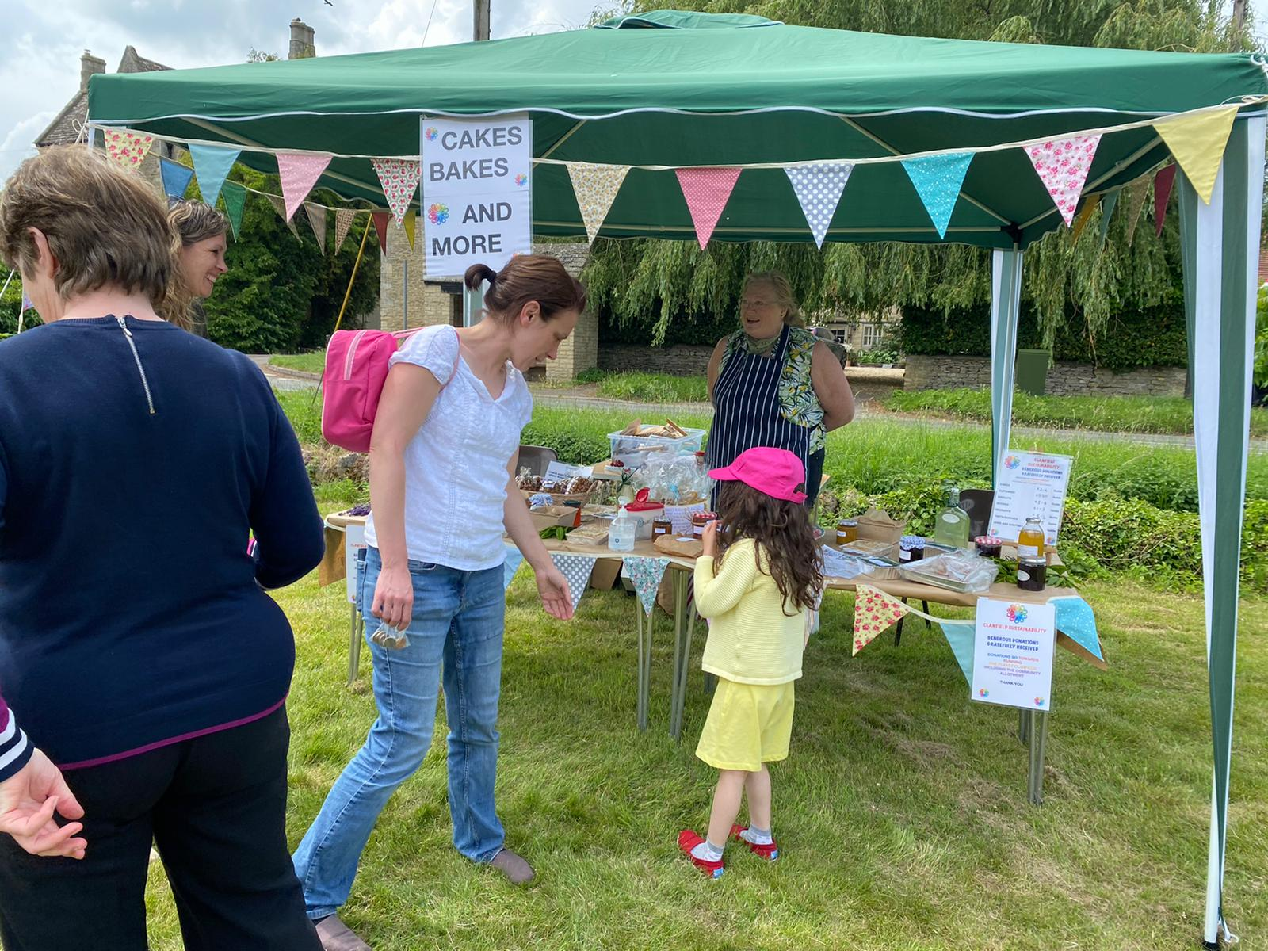
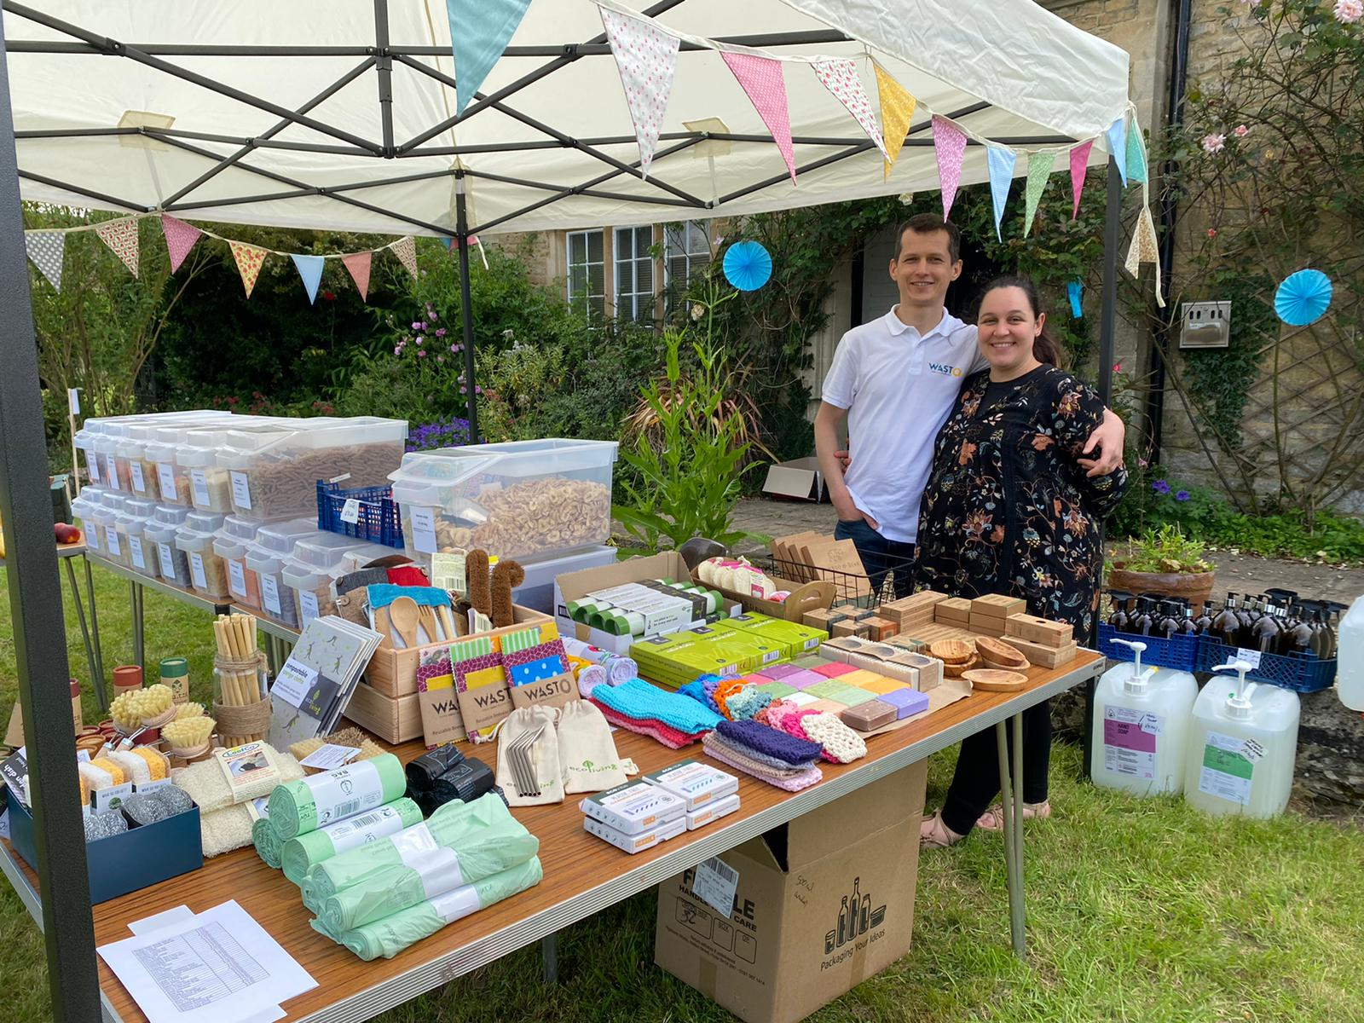
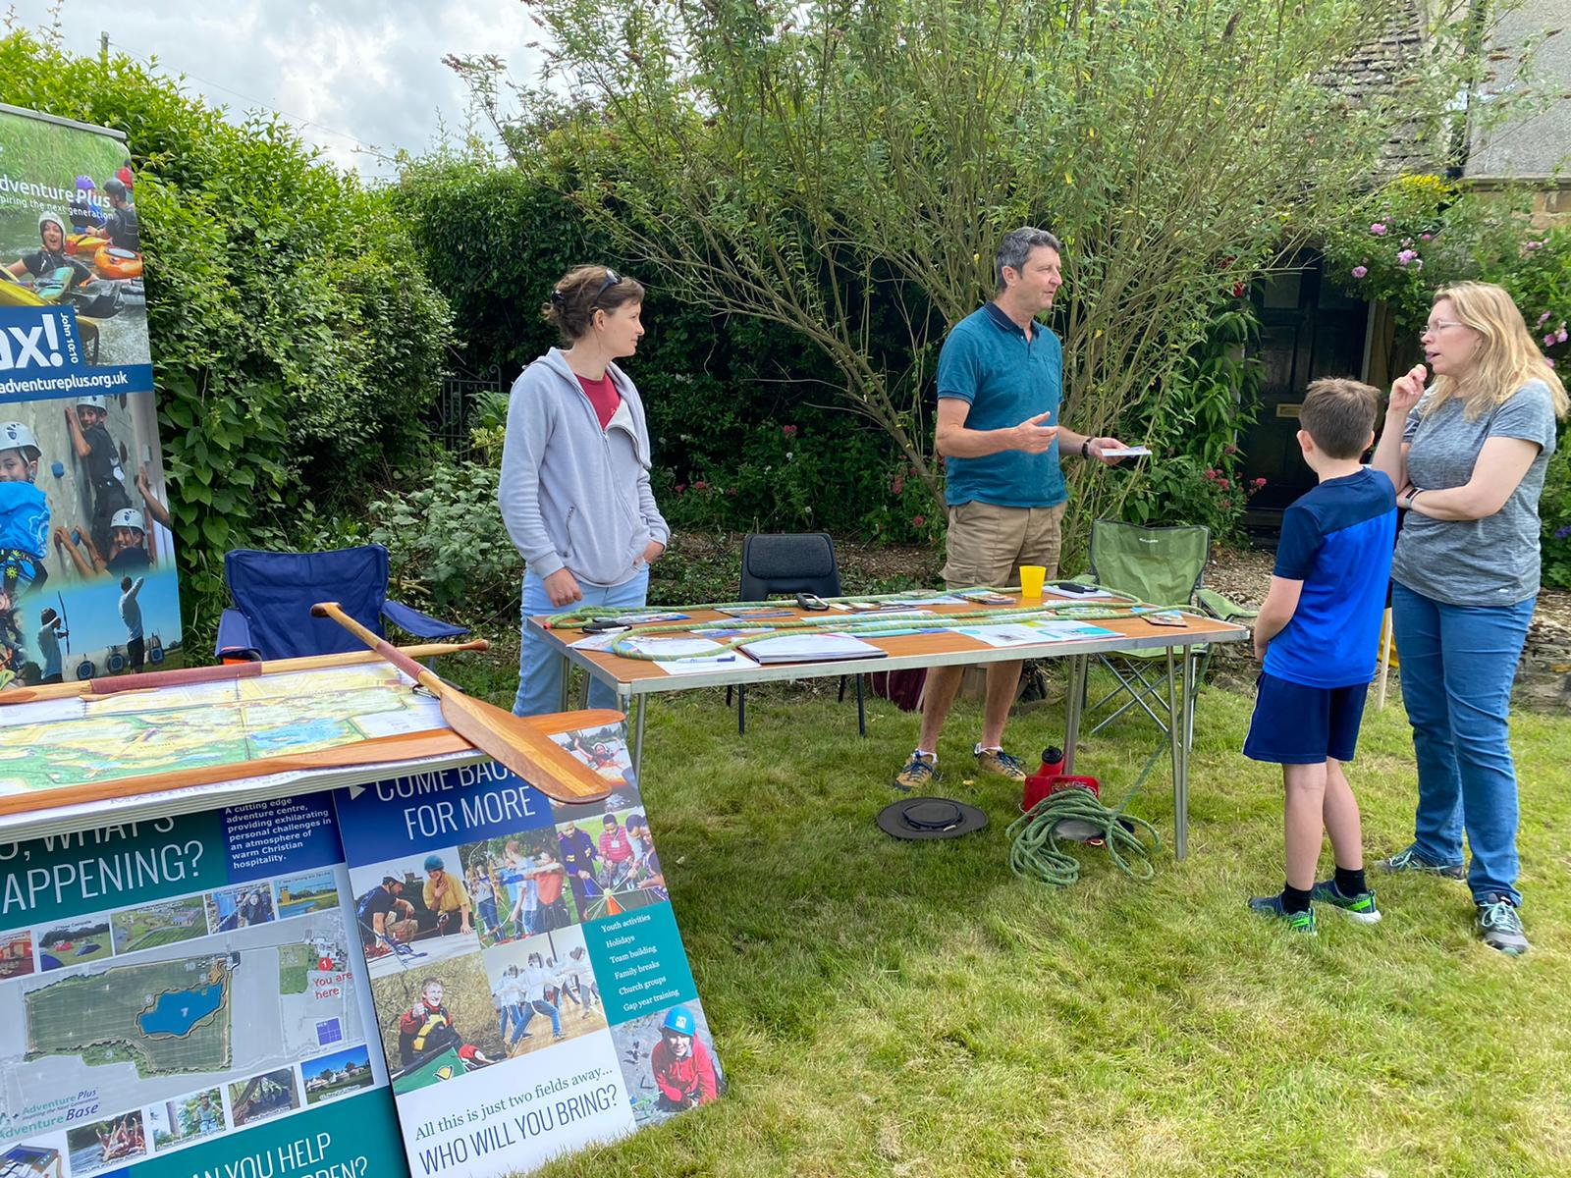
Notes:
Regular sustainable Saturdays – inspired by Bruton, Apple pressing – Oxford Library of Things through CAG. Support and encourage Wast0 and Adventure Plus
Tried working with local school but difficult in Covid – may try again.

Slide 14



What next?
Whatever people feel inspired to do!
Notes:
Possibly work with other Orchards, develop workshops (sharpening, mending etc) suggested by RC volunteers. Create our own website and fb page.

